Slide 1


KOBO FINTECH QE PROJECT

Slide 2
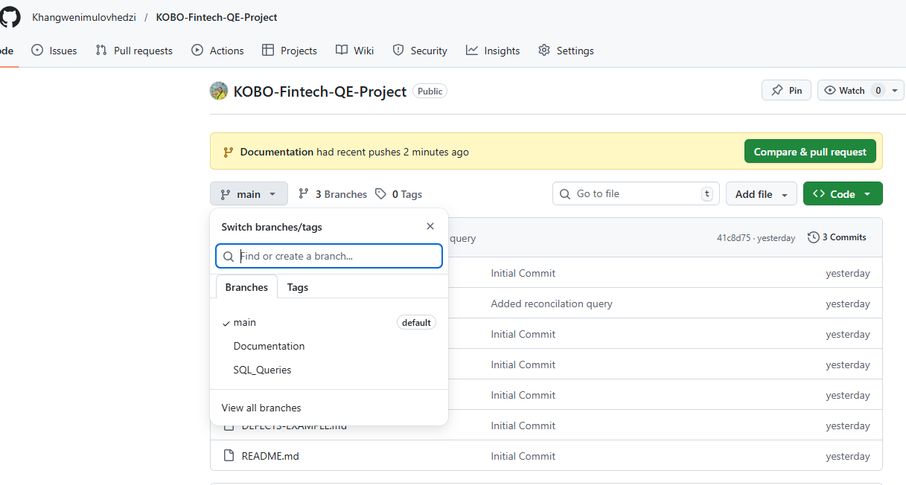
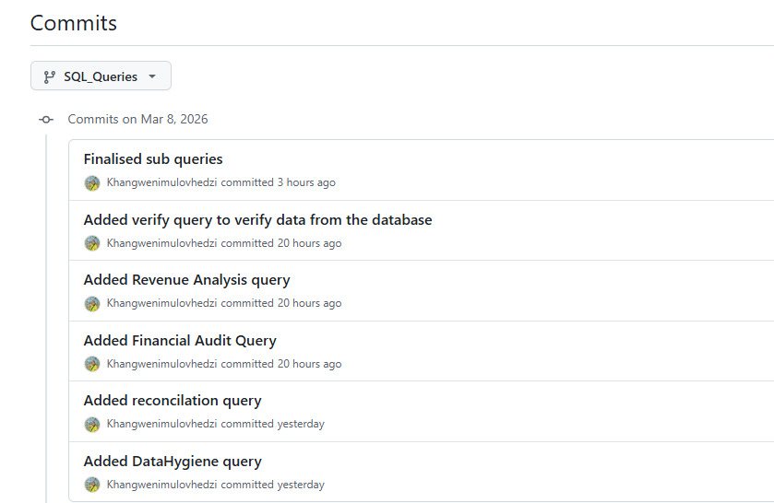
Team Workflow and Git Contributions
Repo created with 3 branches
Each task committed separately

Slide 3
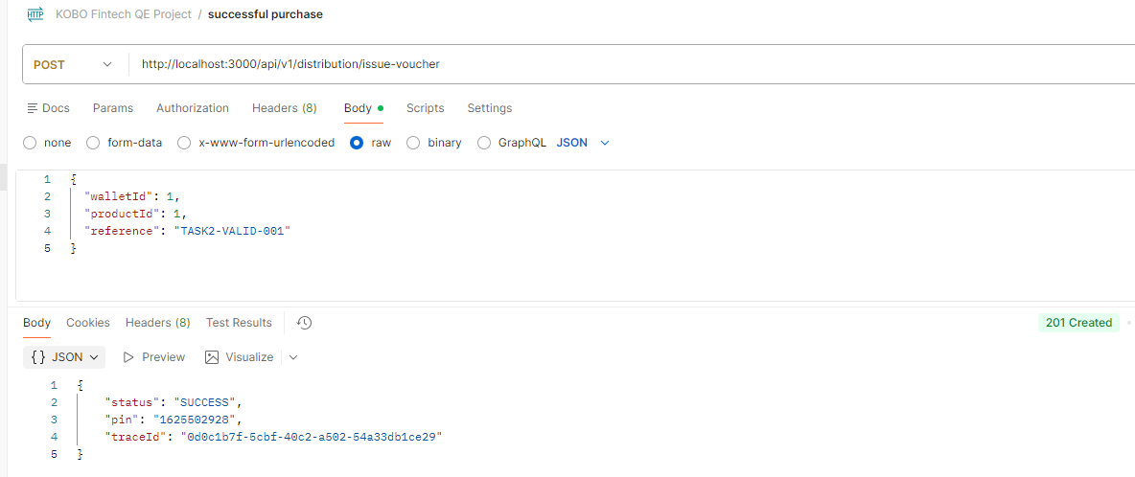
Postman Automation demo and results
Successful voucher issuance
Sent a POST request to the /api/v1/distribution/issue-voucher endpoint with a valid wallet ID, product ID, and reference number.
The API returned a 201 Created response with a status of SUCCESS, along with a generated voucher PIN and trace ID.

Slide 4
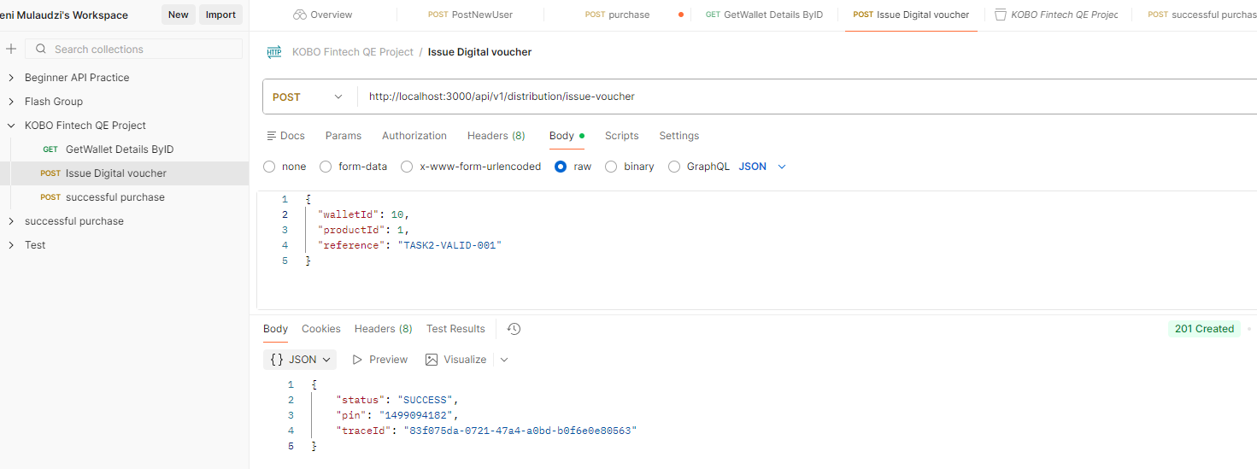
Postman Automation demo and results
Low wallet balance transaction
The wallet we used had a balance of R5.00, while the product price was R10.00. When we sent the request to issue a voucher, the API still returned a 201 Created response with a status of SUCCESS and generated a voucher
The system allowed the transaction even though the wallet did not have enough funds and the balance became negative.

Slide 5
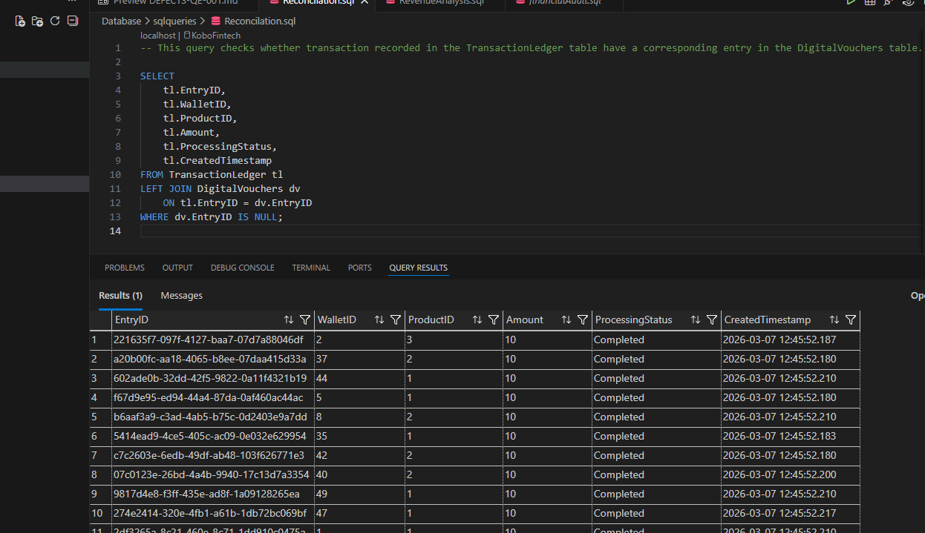
Red Flag SQL Query
Reconciliation query
This important query checks for transactions in the ledger that do not have a corresponding voucher.
This is important because in a fintech system every completed transaction should result in a voucher being issued.
If this relationship is broken, it indicates potential financial inconsistencies.

Slide 6

Top 3 System Flaws Discovered
No Balance Validation
Wallet balance is not checked before voucher issuance.
Disabled users can still transact
The system does not verify user service status.
No data Transaction Handling
If the system fails during processing, financial data may become inconsistent

Slide 7
Answers to Task Questions
Task 1 Question: If you were testing this API in a "Staging" environment versus a "Local" environment, how would you change the dbConfig in server.js to ensure sensitive credentials are not leaked in your GitHub history? | Credentials should be stored using environment variables instead of hardcoding them.
Task 3 Question: Identify a specific data type used in the database tables that is problematic for banking. Provide a SQL example of why this specific choice is a defect. | Using the FLOAT data type for financial values can cause rounding errors. The correct type is DECIMAL(18,2).
Task 4 Question: If the system crashed mid-transaction, which table is most likely to end up with "Dirty Data" based on the current logic? How would you fix this? | If the system crashes during a transaction, the TransactionLedger table may contain dirty data. Using database transactions can prevent this issue.

